Slide 1
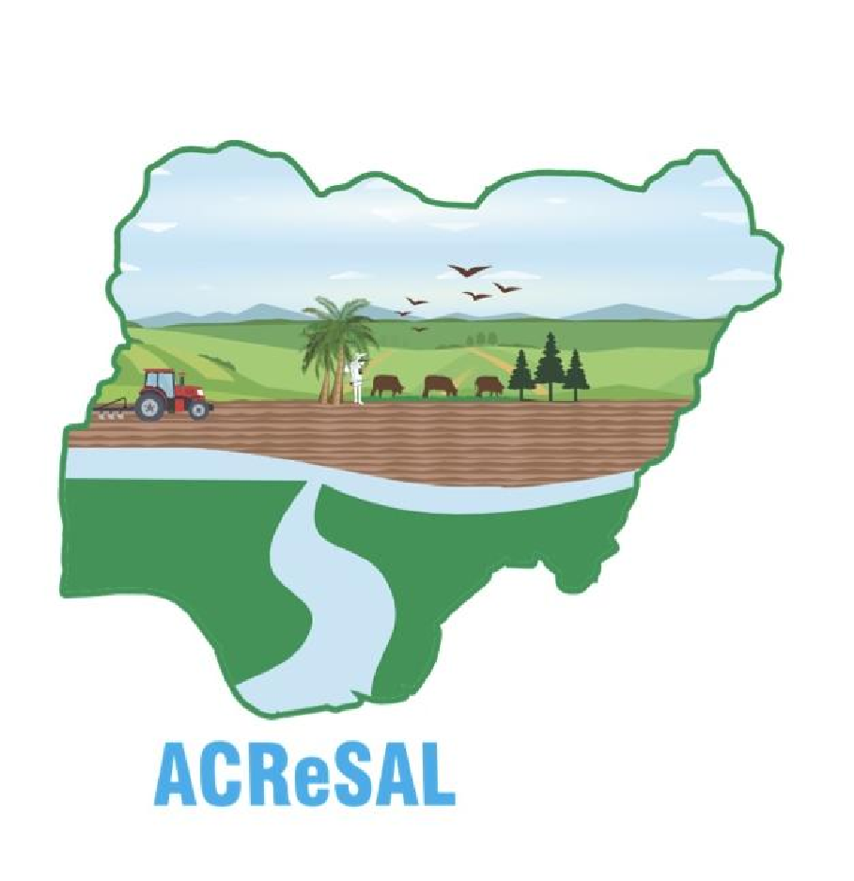


GOMBE STATE ACReSAL
PROJECT IMPACTS DEC. 2025
Dry Land Management: Degraded Land
Rehabilitation.
BUILDING COMMUNITY
CLIMATE RESILIENCE
Community strengthening and investment
STRENGTHENING INSTITUTIONS AND SUPPRTING POLICIES
Institutional Infrastructure, Longer-term policy and institutional frameworks to promote integrated watershed management, Capacity building and outreach.

Slide 2

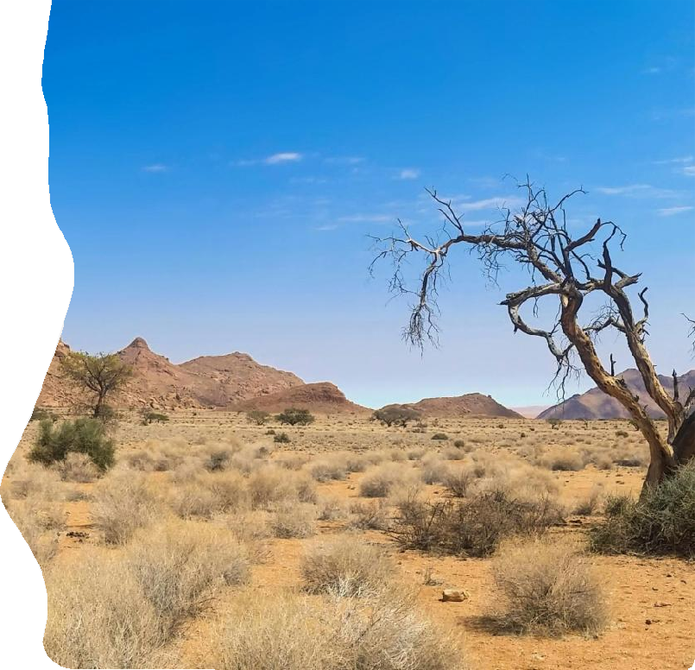
Component A Dryland Management
A1: Strategic Watershed Planning
Integrated approaches (Policy & Institutional Environment) – including knowledge base/analytics & project-related policy innovations
Strategic Watershed Planning (analytical & stakeholder inputs)
A2: Landscape Investments
Large area watershed investments (including afforestation, windbreaks, dunes, etc.)
Rehabilitation of deep gullies, dams, and other infrastructure
State-level program enhancement
A3: Special Ecosystems
Forests and Protected Area management
Oases
Wetlands
Woodlands

Slide 3
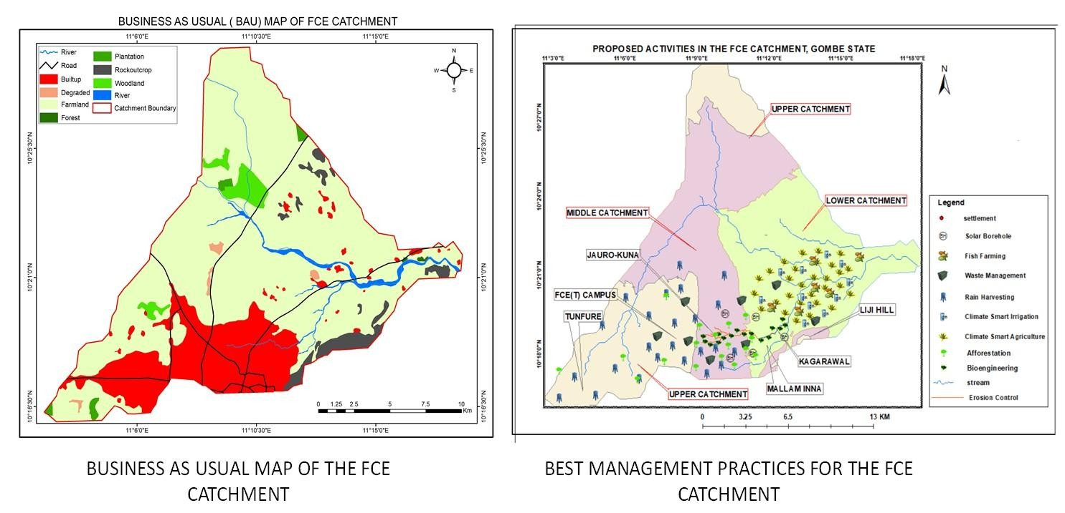
Component A2
BUSINESS AS USUAL (BAU) OF FCE CATCHMENT

Slide 4
Component A2
21KM FCE(T) Gully System
The State has launched a comprehensive gully reclamation initiative, supported by the World Bank's ACReSAL Project, focusing on the FCE(T) catchment and adjacent communities. This initiative employs an integrated approach that combines both soft and hard structural solutions.
Impact Category | Status Before Implementation | Current Status After Implementation
Deaths | 35 | Nil
Houses lost | 200 | Nil
Houses destroyed | 200,000 | Nil
Communities cut off | 11 | Nil
Schools/Health Facilities | 10 | Nil
Farmlands Consumed | 2,000 | Nil
Livestock lost | 1,700 | Nil
Direct beneficiaries | - | 208,541
Indirect beneficiaries | - | 1,391,459
Total area degraded | 57,453.8 | Nil
Total hectares recovered | - | 57,453.8
Total number of jobs created (Skilled & Unskilled | - | 7,661
Total number of people affected | Over one million | -
Total beneficiaries |  | 1.6 million
Key Impacts (2005–2024):

Slide 5
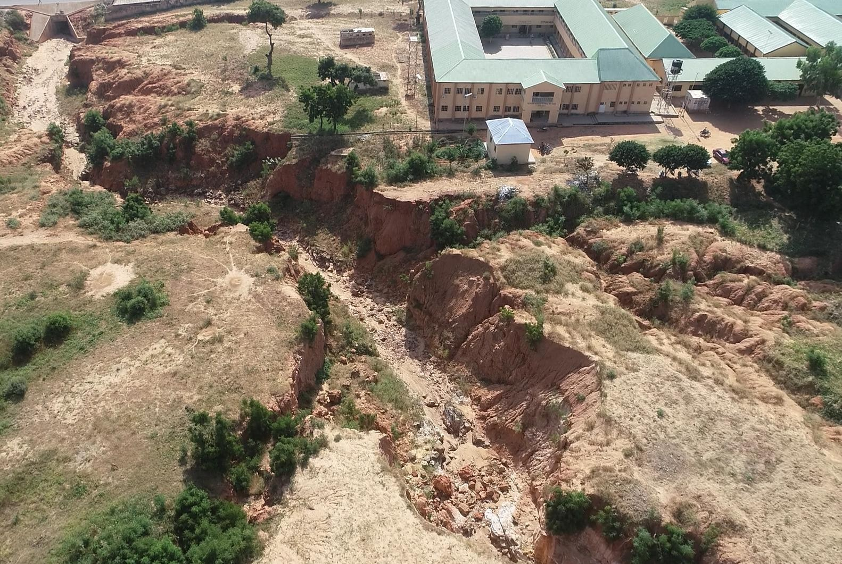
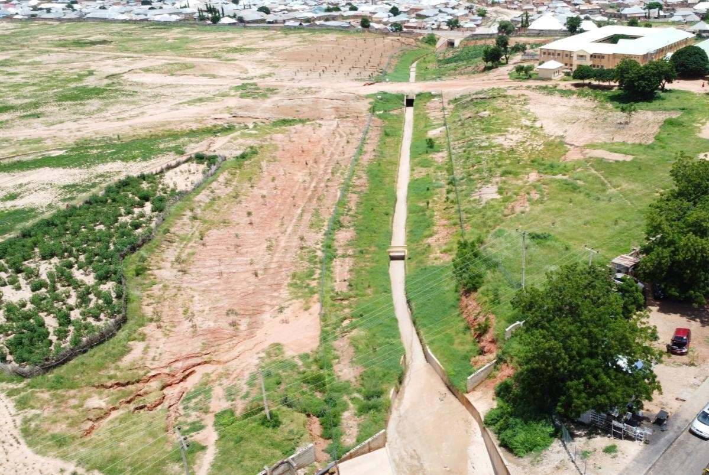
Component A2
FCE(T) Gully Head
FCE(T) Staff School
FCE(T) Staff School
Before
After

Slide 6
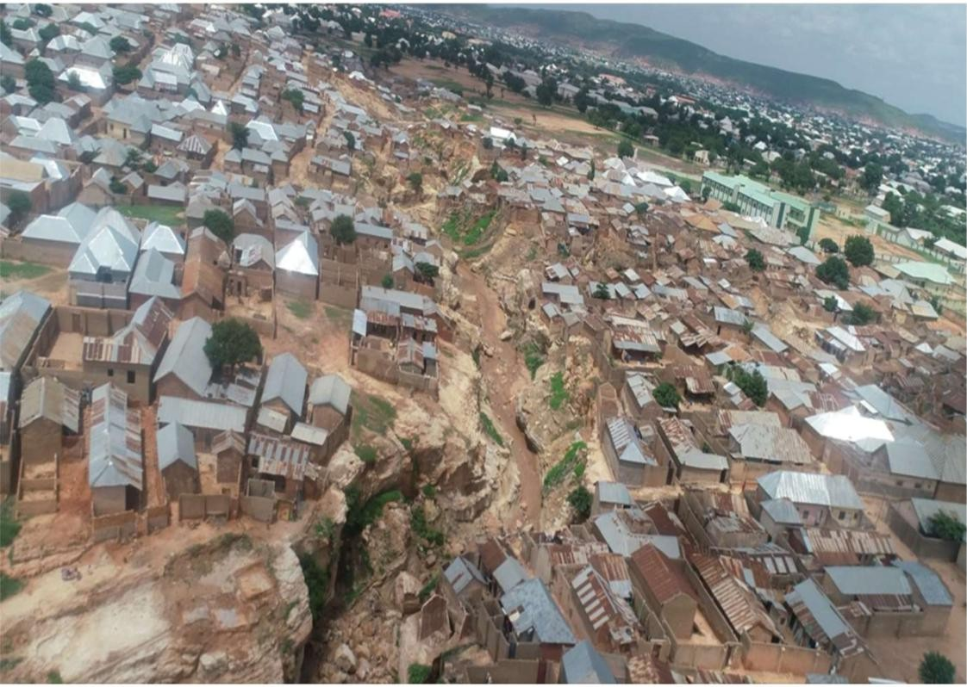
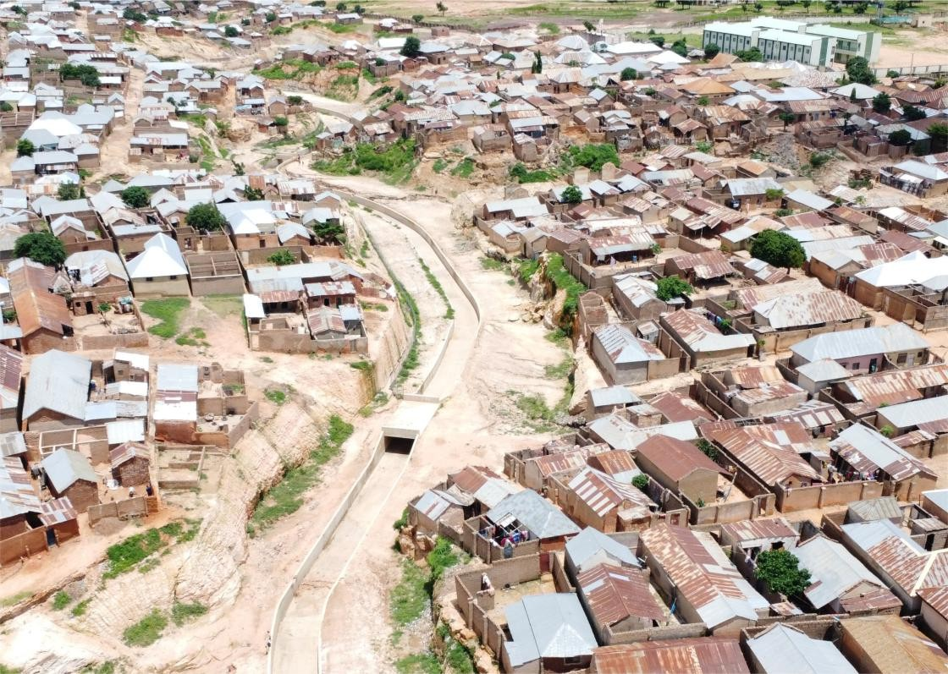
Component A2 FCE(T) Midstream
Before
After

Slide 7
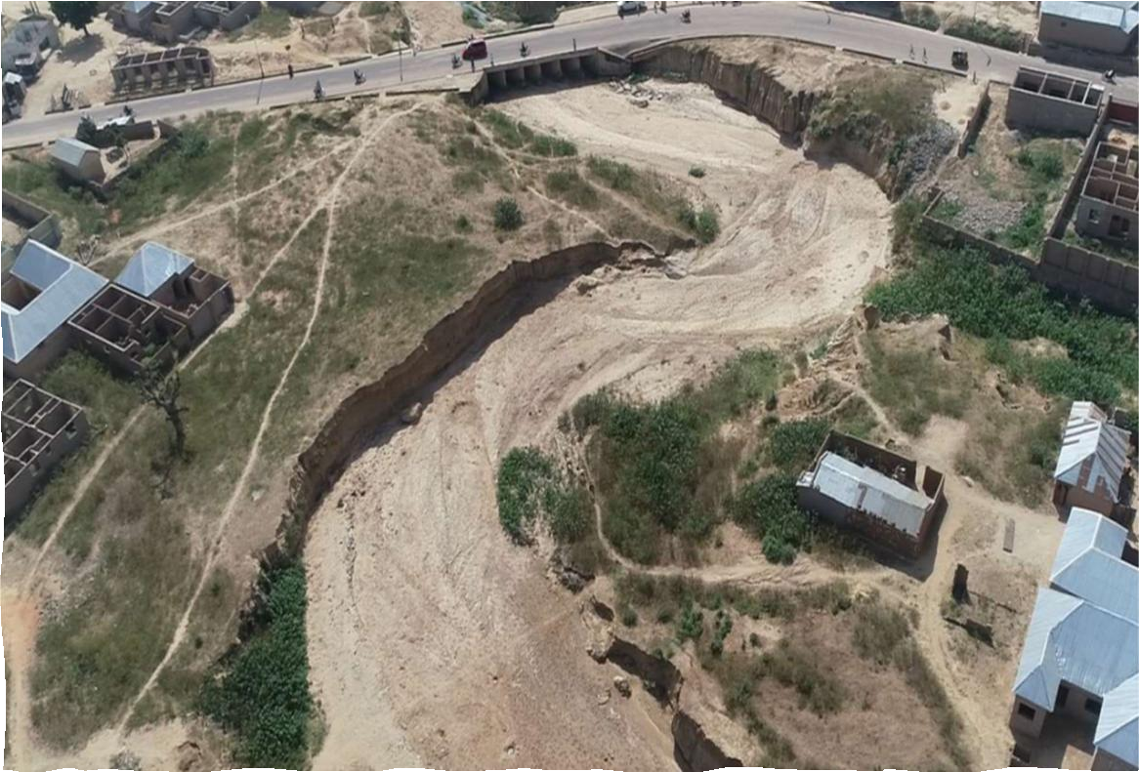
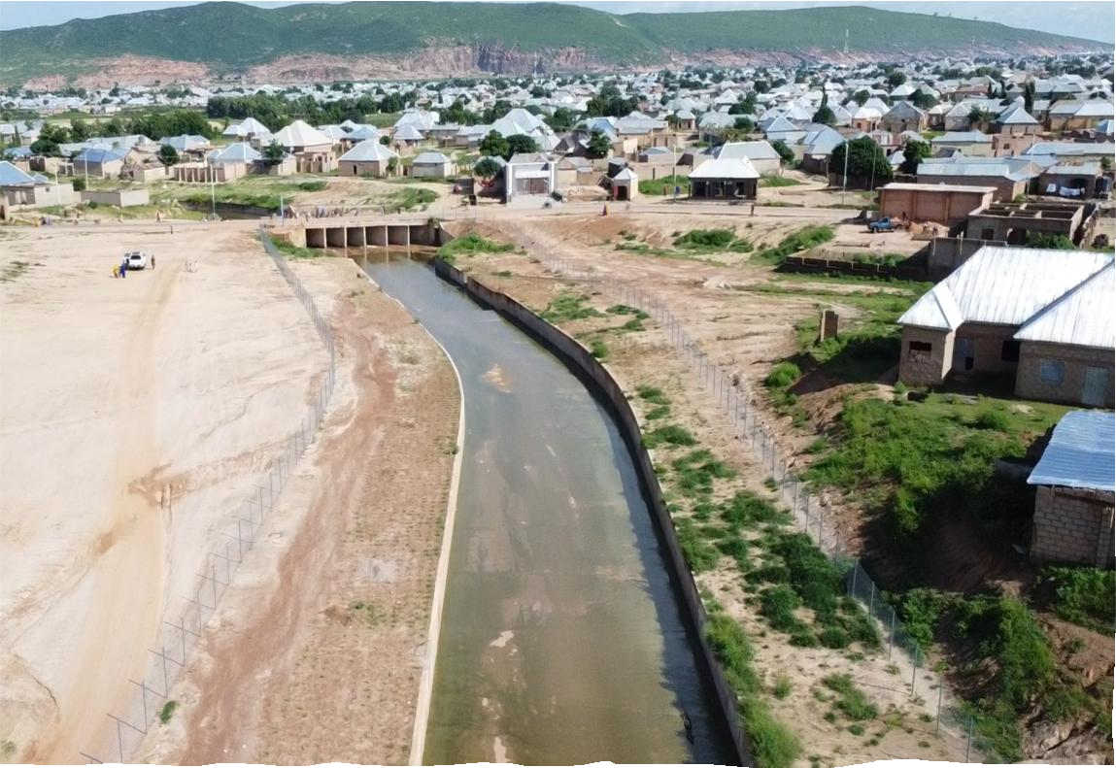



Component A2 FCE(T) Downstream
Before
After

Slide 8
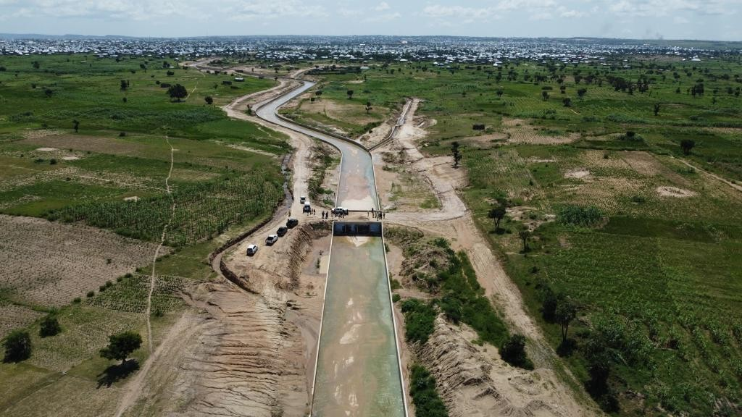
Component A2
21KM FCE(T) Gully System
Key Impacts:
37%
Crime rate reduction.
70%
Increase in Social cohesion among the adjoining communities
26%
Increase in School enrollment/retention.
180%
Increase in Land
value
A water channel in the FCE catchment
18%
Reduction in the prevalence of diseases.
18%
Local trade volume: 16% increase.

Slide 9

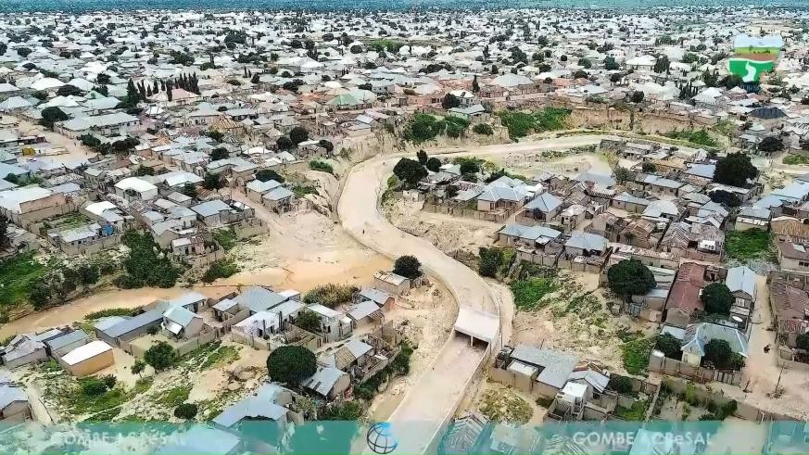
FCE Catchment Beneficiary Testimonials
9
Gombe State Dep. Gov. Mannassah Daniel Jatau: For Combe State, honestly, the coming of ACReSAL has changed a lot of lives. You have seen that we are the masters; we were the headquarters of gully erosion. And there were serious threats to lives, properties, and academic institutions. Combe State University, the Federal College of Education, where we trained teachers, were all in danger of collapse but for the coming of ACReSAL. But now we are proud, we are happy, and we can always do our school activities without any threat.
Quite apart from that, there were so many lives that have been saved because there were houses that, at the time, more than 30 houses were washed away. Do you remember that time? But now we are free from such. Even though there are still embankments to be backfilled.
But quite apart from that, agriculture, which is the mainstay of the state, is getting a very big boost. The work in one of the sites, which is the Balanga dam, has an arable land of 11,000 hectares. With the work that ACReSAL is doing there, by opening canals that once existed but collapsed, I can assure you that 10,000 farmers will be engaged in agricultural activities for rice, wheat, and others. This is for us are avenues that can create jobs and can create employment, employment opportunities.
Danjuma Abdu: If you tell them that there is a World Bank, they will not agree… But with the presence of this project, they will definitely say, not only the World Bank, they know that there is a partnership not only between the World Bank and other countries in the world, and Nigeria is a partner, not only Nigeria, but even the Gombe state government. Definitely, our people are highly pleased with this project, and they appreciate what the World Bank, Gombe state government, and ACReSAL are doing.

Slide 10
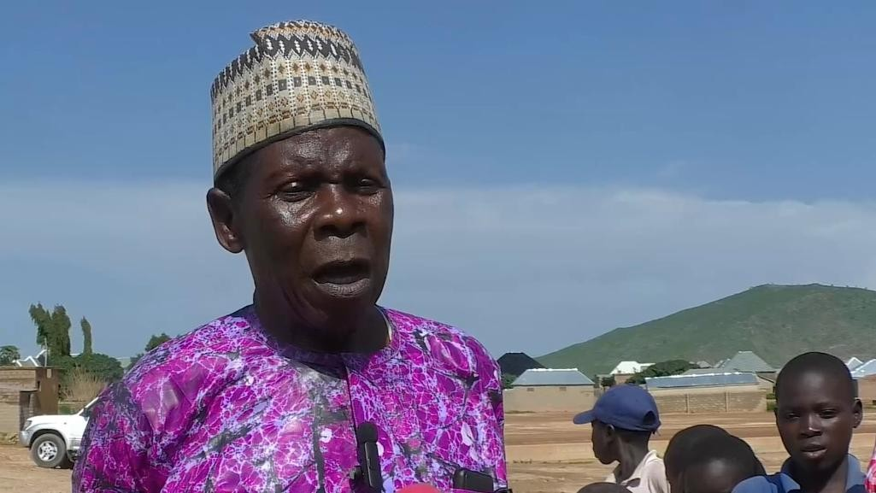
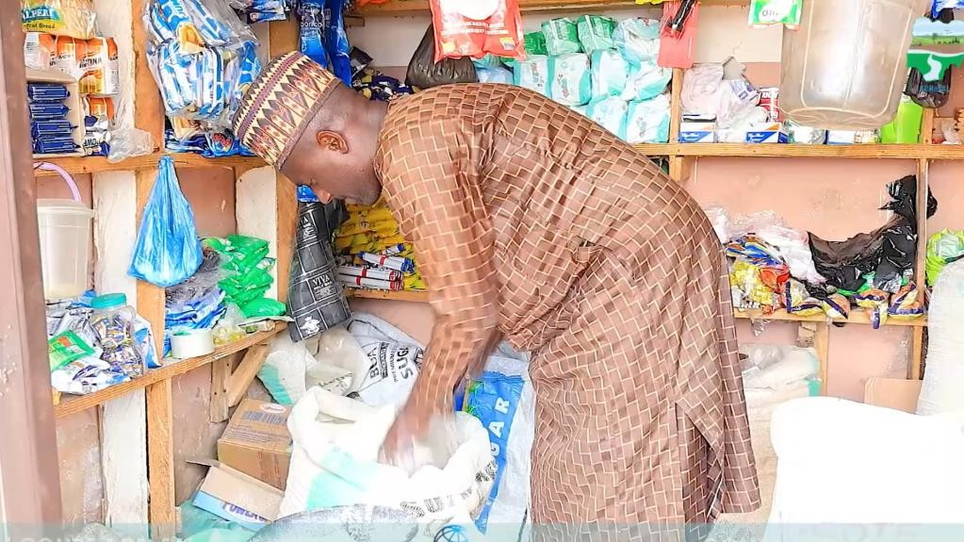
FCE Catchment Beneficiary Testimonials
10
Mr. Pater Wahadata: It has affected our schools, children, our families, and our businesses. Whenever there is rainfall, we cannot go to the farm, our children cannot go to school, and we cannot go to the market, even public transport fare was high because of the erosion. God supported us through ACReSAL and wiped our tears. When they came, we thought it was a joke, but in the long run, we had great results.
Ibrahim Abdullahi: The Gully erosion control project has affected my business positively. I have received compensation for my assets that were threatened by gullies, and I have now moved to a new location that enables me to earn more. I could sell provisions of thirty thousand naira (₦30,000) there per day, but here, minimum sales start from fifty thousand naira (₦50,000)per day. You can see that I have made progress.

Slide 11
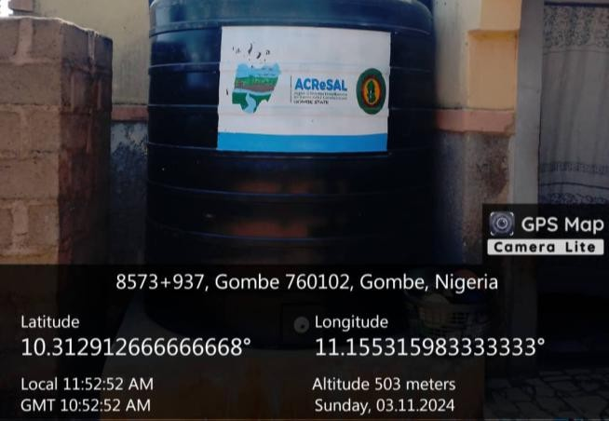
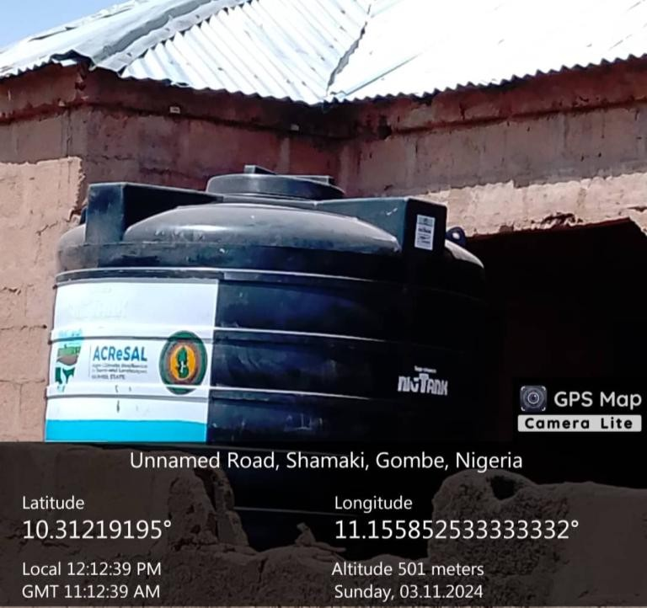
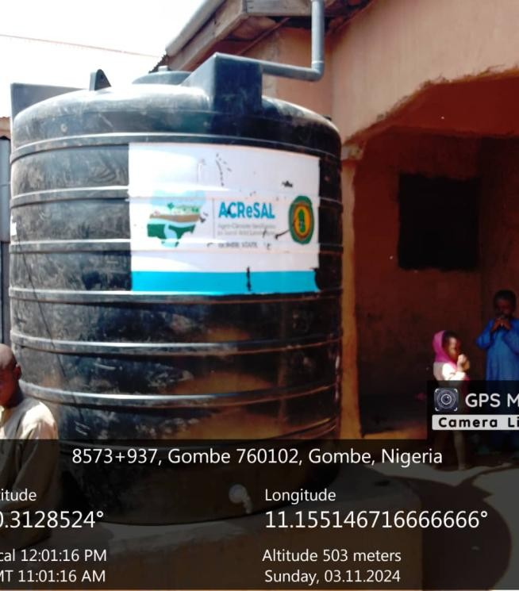
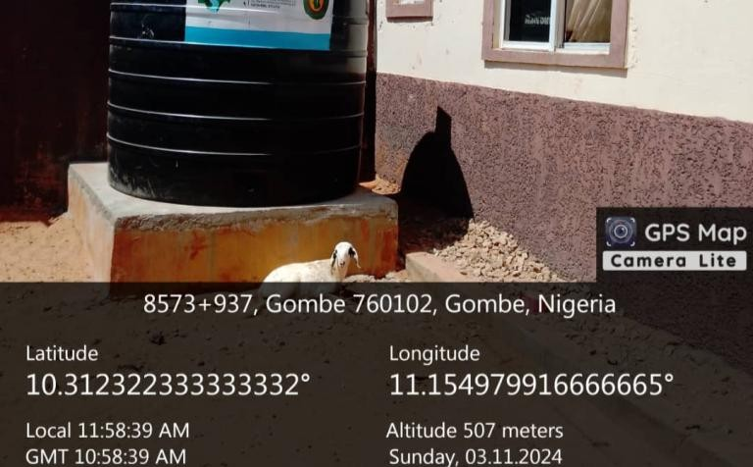
Component A2
FCE(T) Catchment
Water Harvesting System: 450
households (4,000 capacity tank)
Institutions (FCE and Special Sch) in
the FCE(T) Catchment
Beneficiaries – 4,450
Seasonal reduction of 9 million liters
of surface runoff.

Slide 12
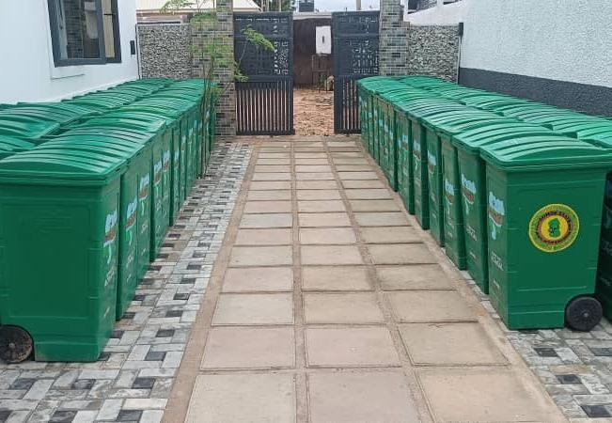
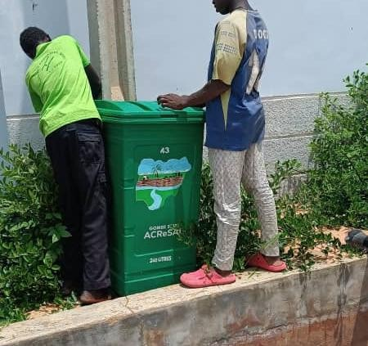
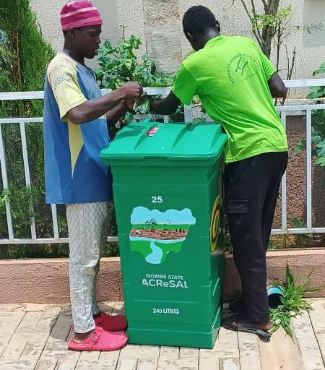
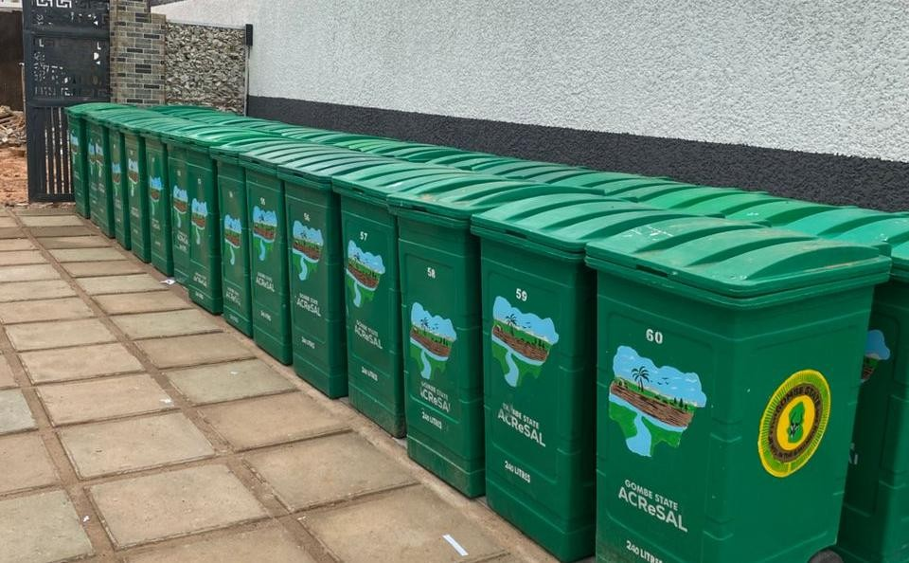
Component A2
110 Waste Bins
• Protecting the environment
• Reducing improper waste disposal
• Preventing floods
• Preventing diseases
• Benefiting 1,100 individuals

Slide 13
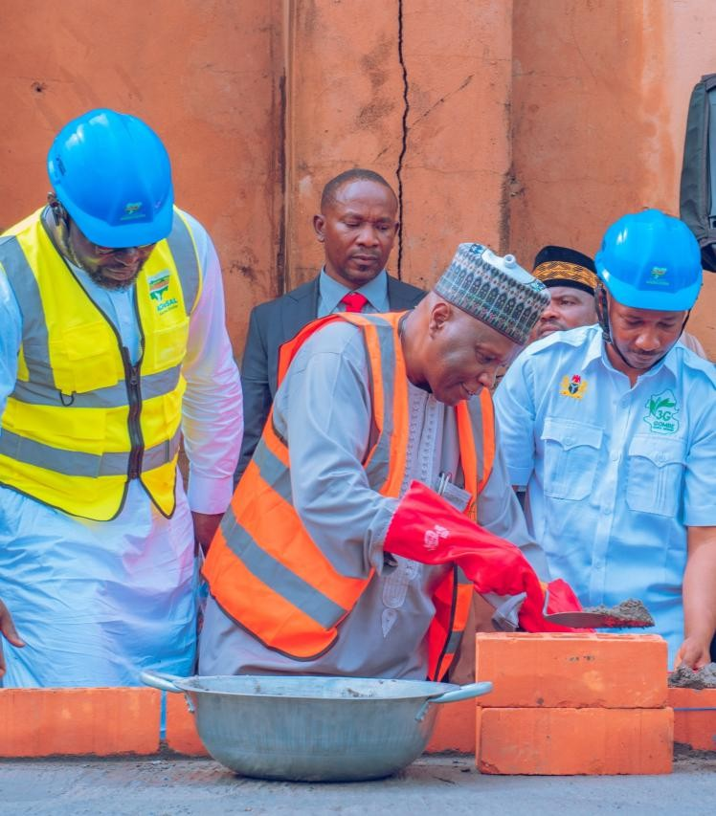
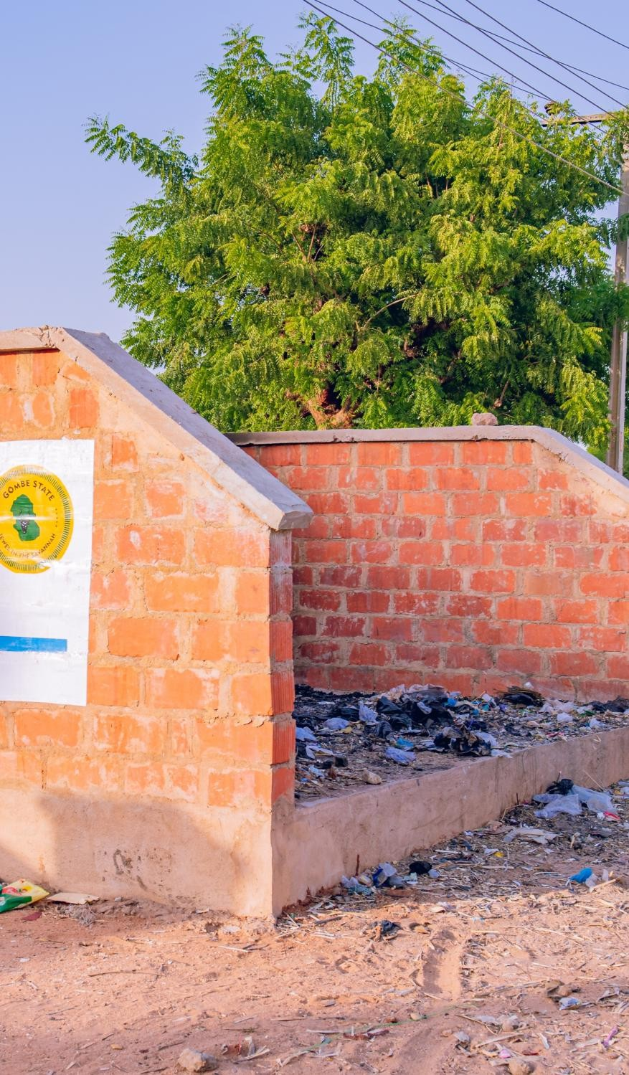
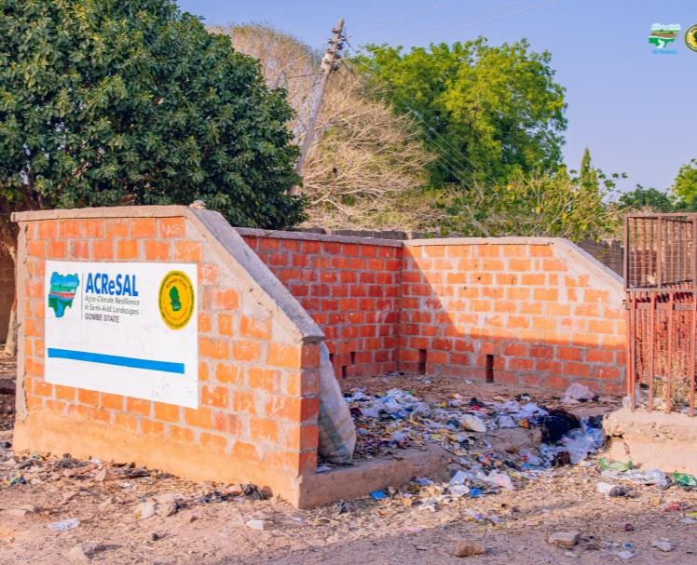
Component A2 Construction of 24 Waste Collection Centres

Slide 14
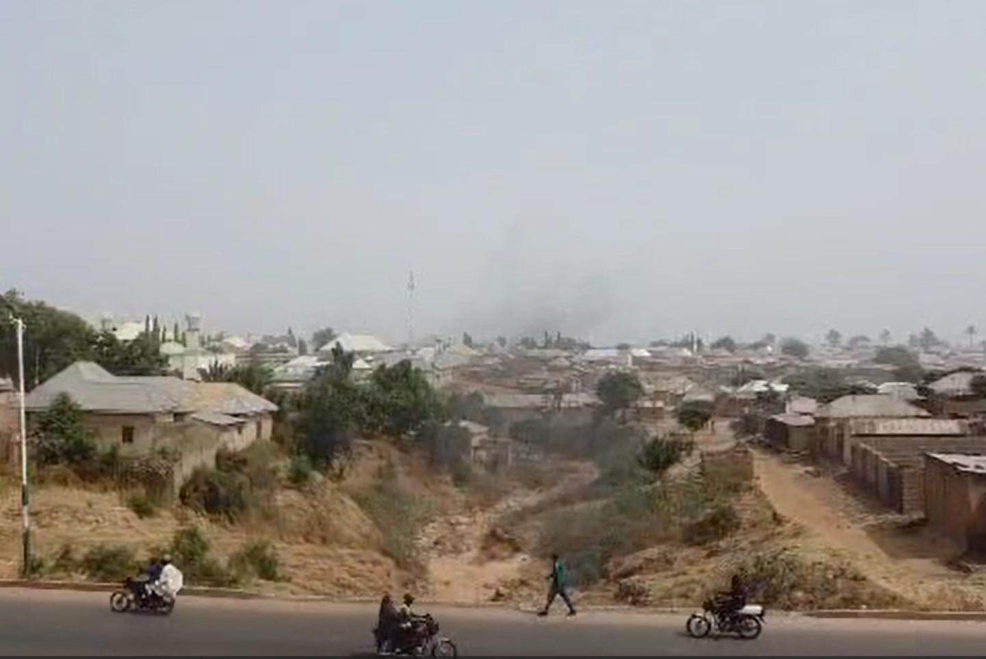
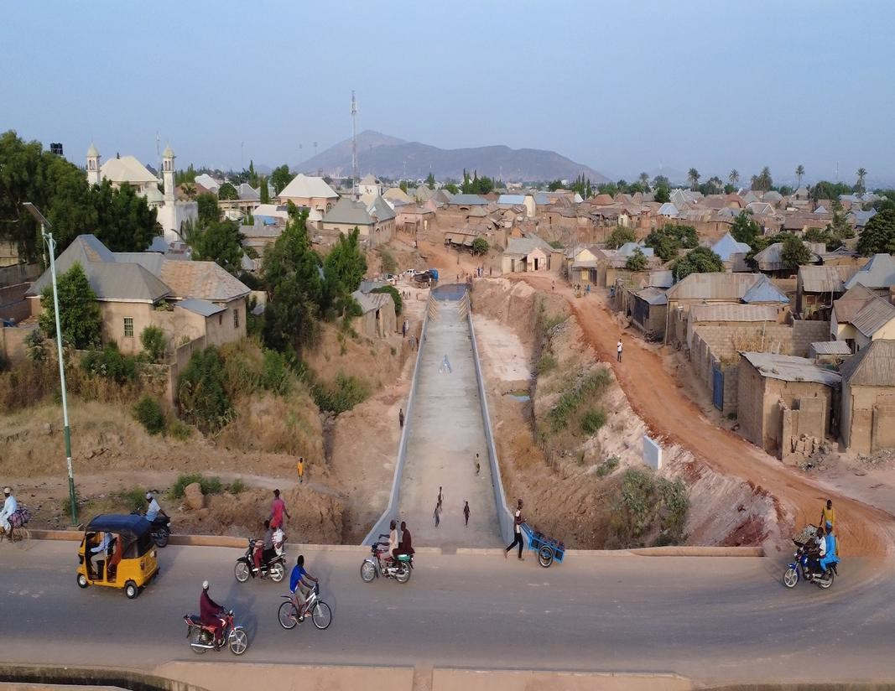
Component A2
GGSS Doma Gully Control Project
Project Length: 18 kilometers
Current Work Progress: 8%
Number of Projected Beneficiaries: 1.4 million
Environmental and Social Management Plan (ESMP): Completed
Resettlement Action Plan (RAP): Completed
Before
ongoing

Slide 15
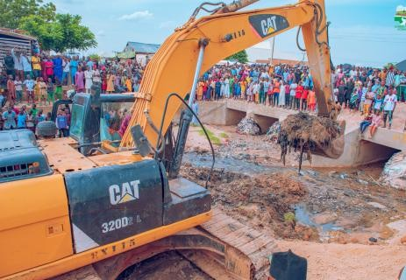
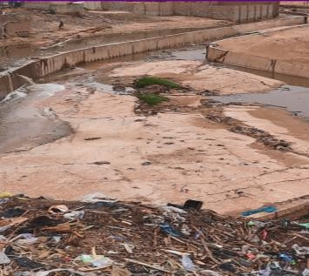
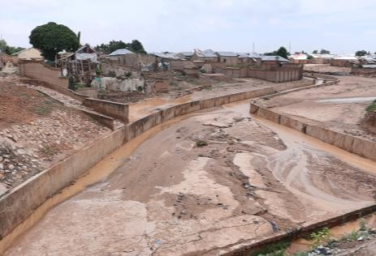
Component A2 DESILTING OF MAJOR STORM DRAINS
13 Major Storm Drains in Gombe Metropolis – 1,858.14 HA:
Key Impact:
Reduction in instances of flood disasters
2B BLOCK INDUSTRY - OLD GRAVEYARD - END
CBN - GAMBO ISARI - KONA ALHARI - ECOLOGICAL CULVERT
FIRE STATION - APPEAL COURT
GOMBE AREA OFFICE – LINK
POLICE BARRACK - YERIMAN GOMBE RESIDENCE - RAILWAY
SHEHU MANZO - MAKERA -PZ RAILWAY
SPECIALIST HOSPITAL - TOWNSHIP POLICE STATION
STATE LOWCOST - ARMY BARRACK - KPNA ALHERI
TASHAN DUKKU ROUND ABOUT - LINK
TOWNSHIP POLICE STATION - LINK
WURO SHIYE – PANTAMI ROAD
KASUWAN FANFO – HURUMIN DAU
GSADP QTERS - BARUNDE BRIDGE
Prevention of flood-related
diseases
Protection of lives and property

Slide 16
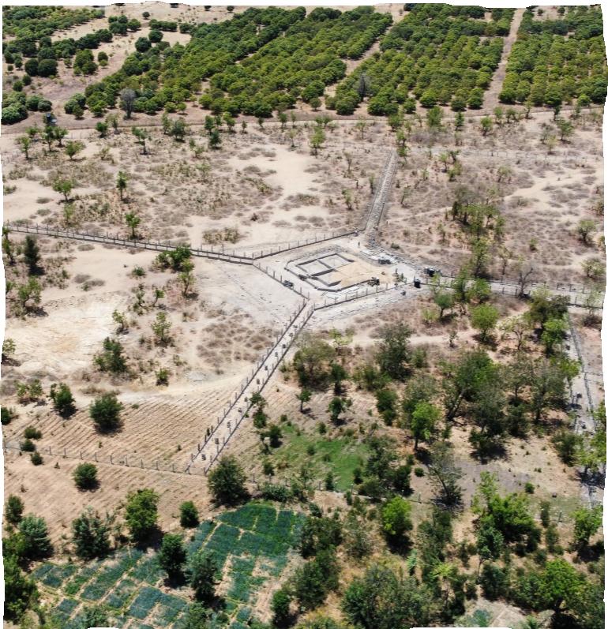
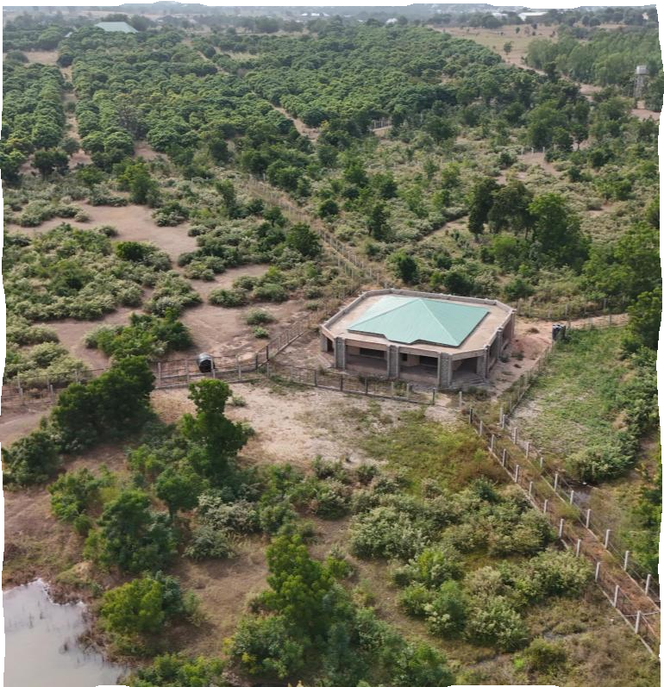
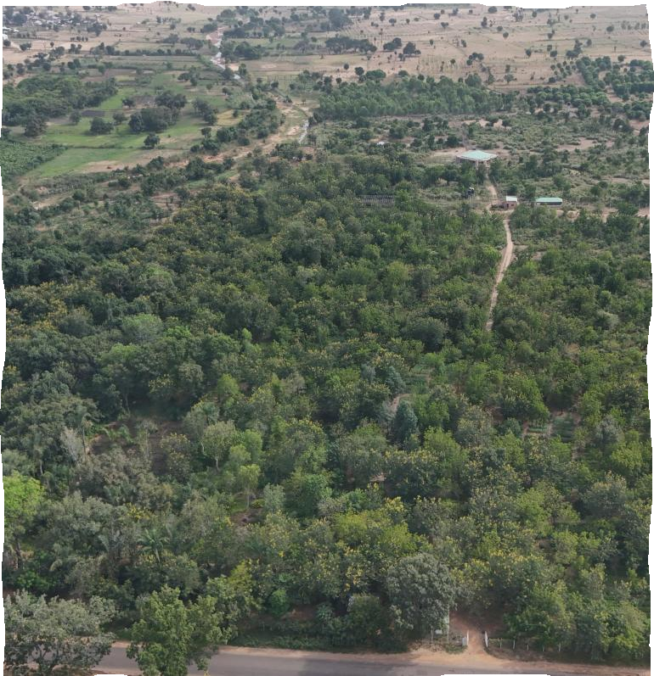
Component A3
Upgrade of Kanawa Forest to a Biosphere Resort and Botanical Garden – 23ha out of 63ha covered
Starting
Ongoing – Natural Regeneration
Key Investment/Activities:
outdoor games and a children's park
Strict botanical garden
Floriculture and Aqua Vista
Agroforestry orchard
Aviary pen
Exhibition stand and lounge centre
Key Impact
Enhance the conservation of indigenous flora and fauna within their natural habitats
Support sustainable resource use by local communities
Promote research, education, and training initiatives to minimize biodiversity loss
and strengthen ecosystem resilience
Promote recreational and social activities

Slide 17

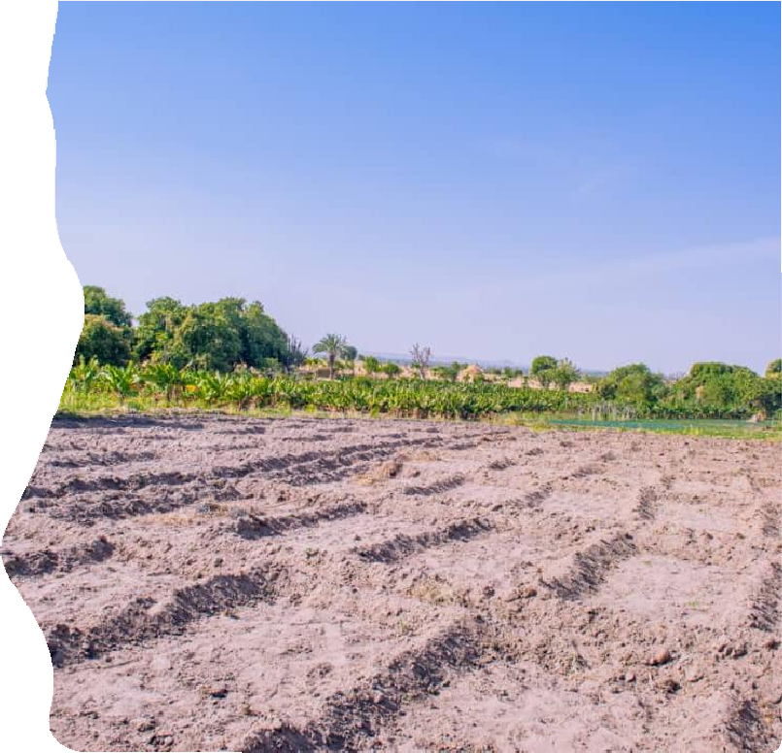
Component B COMMUNITY CLIMATE RESILIENCE
B1: Community Strengthening
Community Engagement/ Social Cohesion/ Peacebuilding
Capacity building
Micro-watershed planning
B2: Community Investments
Landscape restoration, scaling up an approach pioneered by FAO (Delfino plough)
Climate-smart rainfed agriculture.
Water and soil conservation, drought-resistant varieties
(e.g., Iron Pearl Millet and Cowpea, Vit A Maize and Sorghum)
Farmers-led Irrigation Development (FLID), including solar pumps

Slide 18
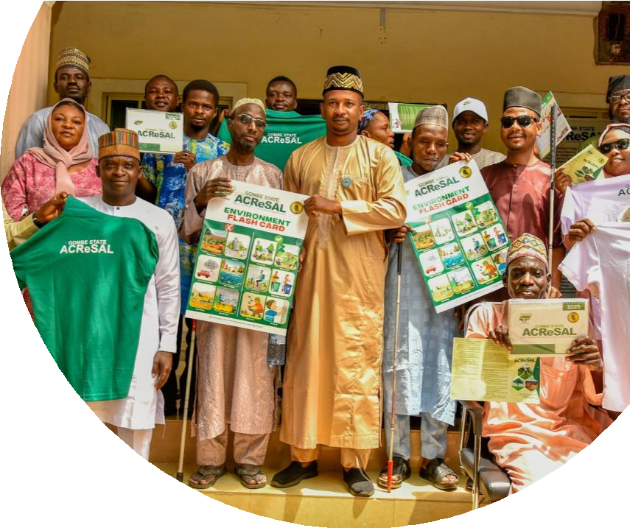
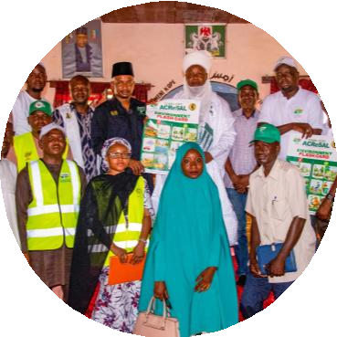
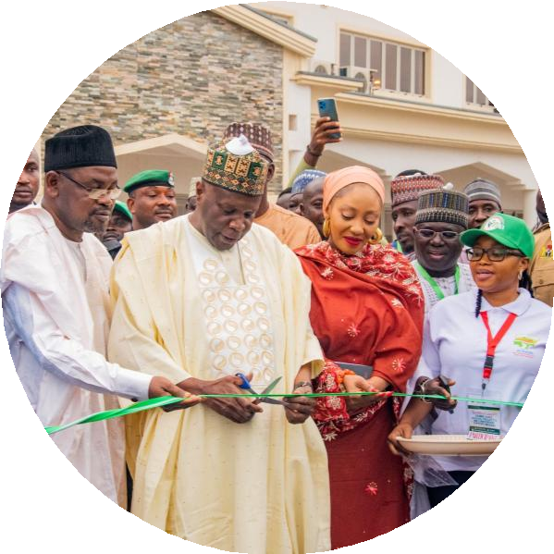
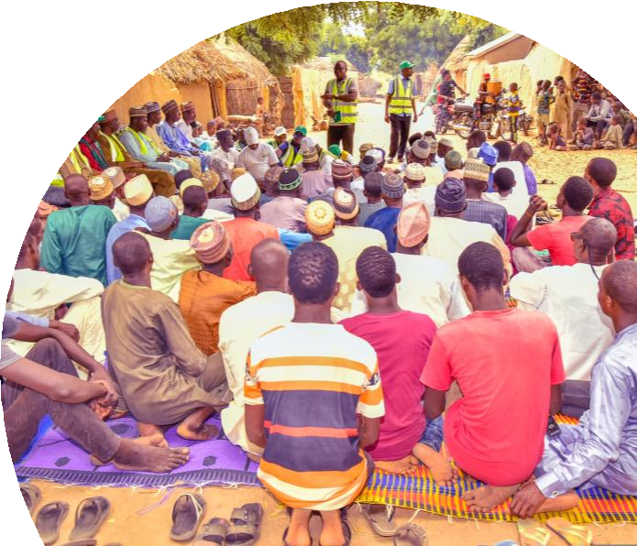
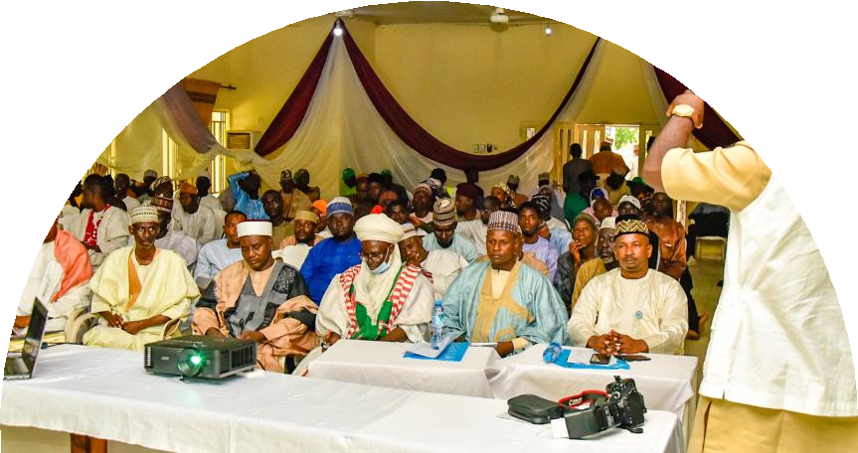
Component B1
STAKEHOLDER ENGAGEMENT, COMMUNITY SENSITIZATION& ENGAGEMENT
KEY IMPACT:
Institutional support from the MDAs
Community and individual participation
High sense of project ownership
Awareness creation

Slide 19
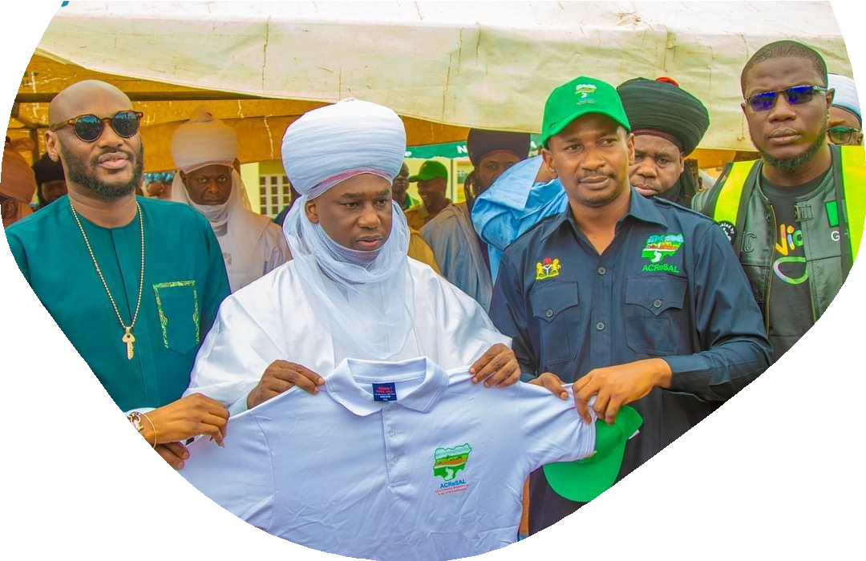
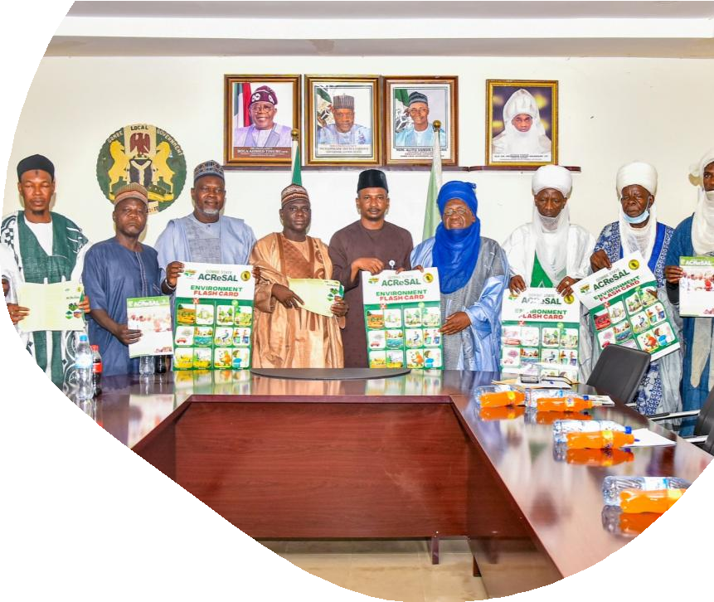
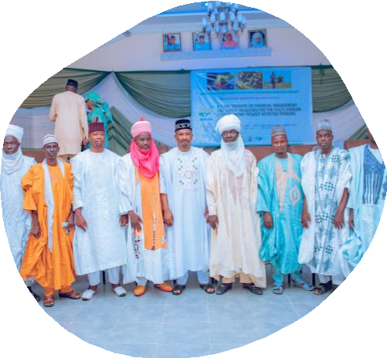
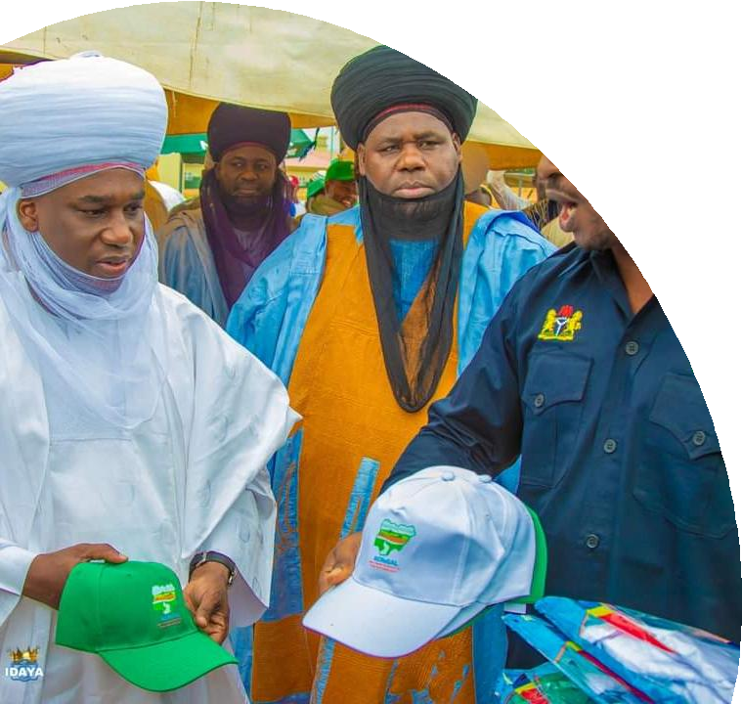
Component B1
STAKEHOLDER ENGAGEMENT/COMMUNITY
SENSITIZATION & MOBILIZATION cont’d

Slide 20

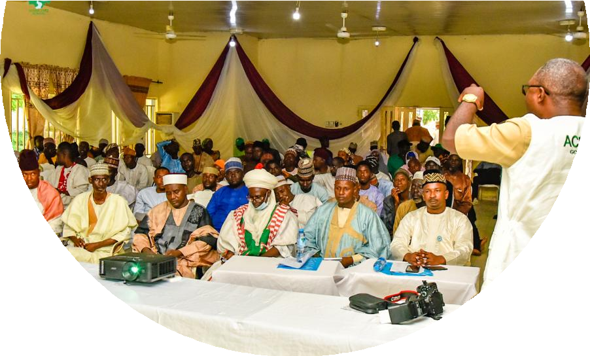
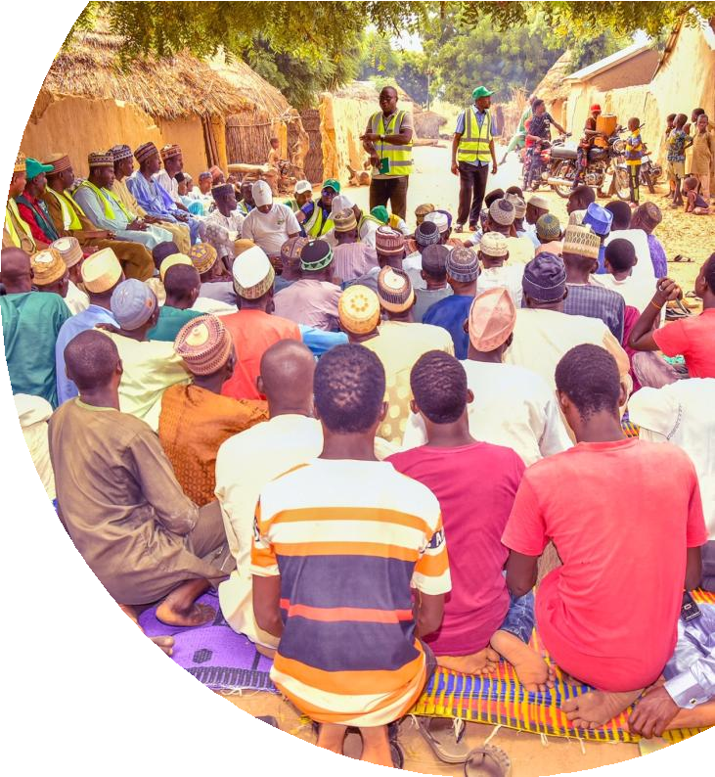

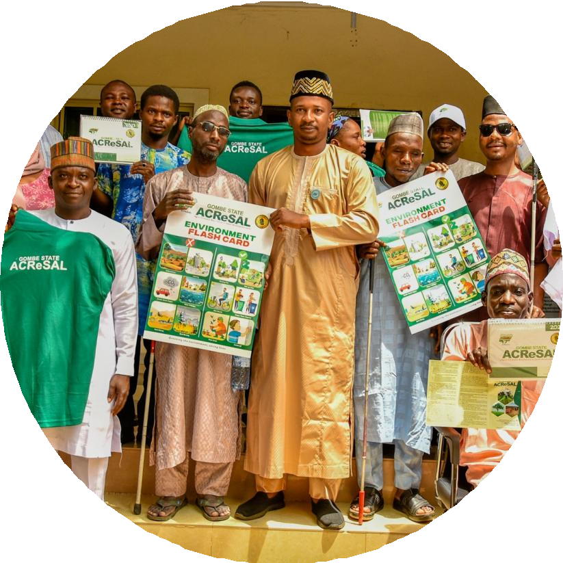
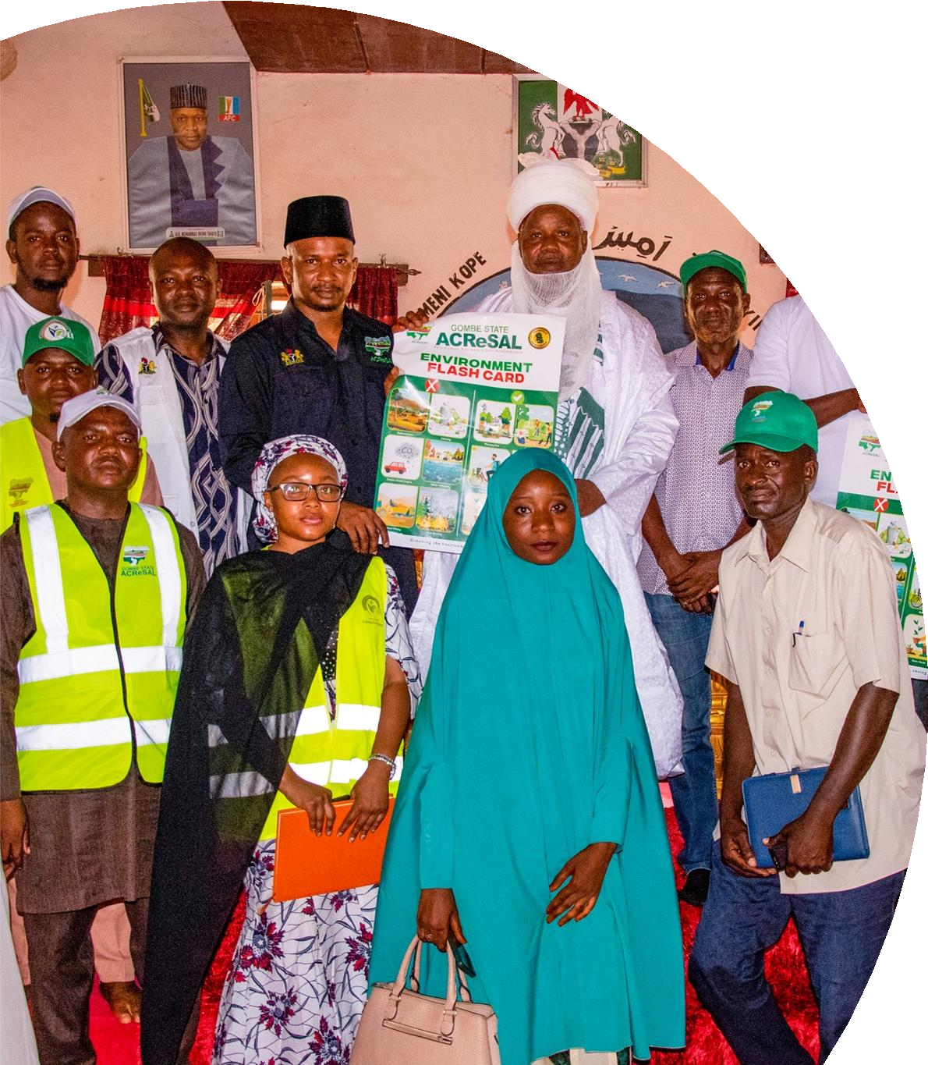
Component B1 STAKEHOLDER ENGAGEMENT, COMMUNITY SENSITIZATION & MOBILIZATION cont’d

Slide 21
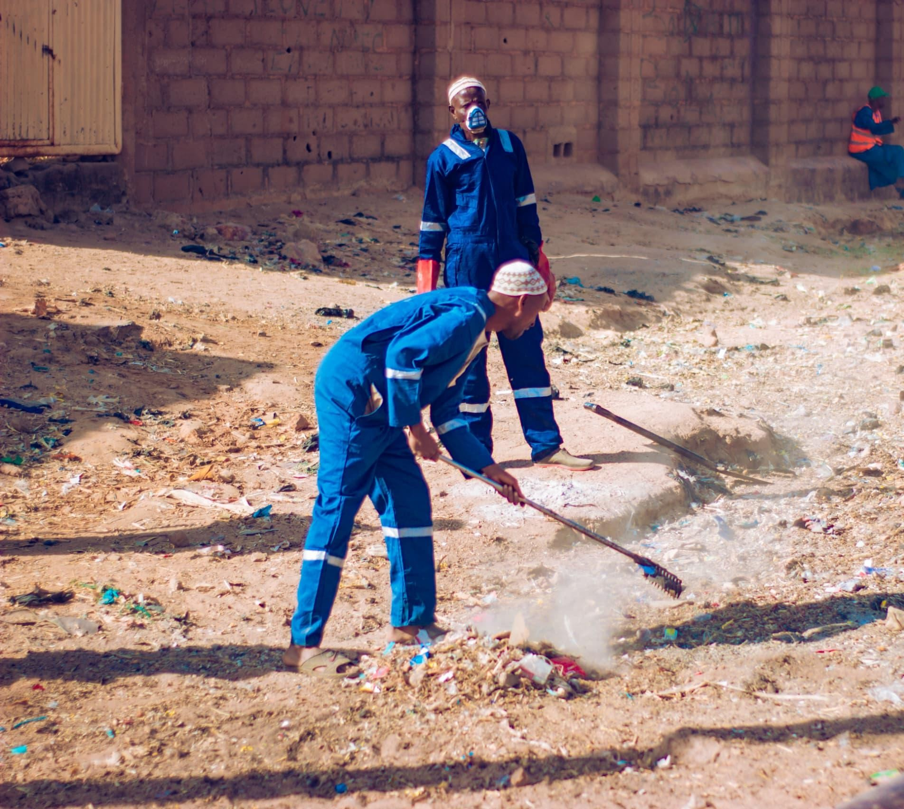
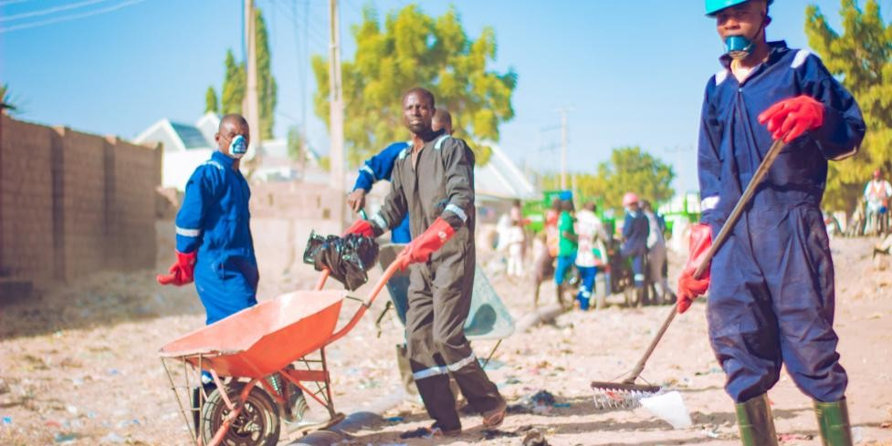
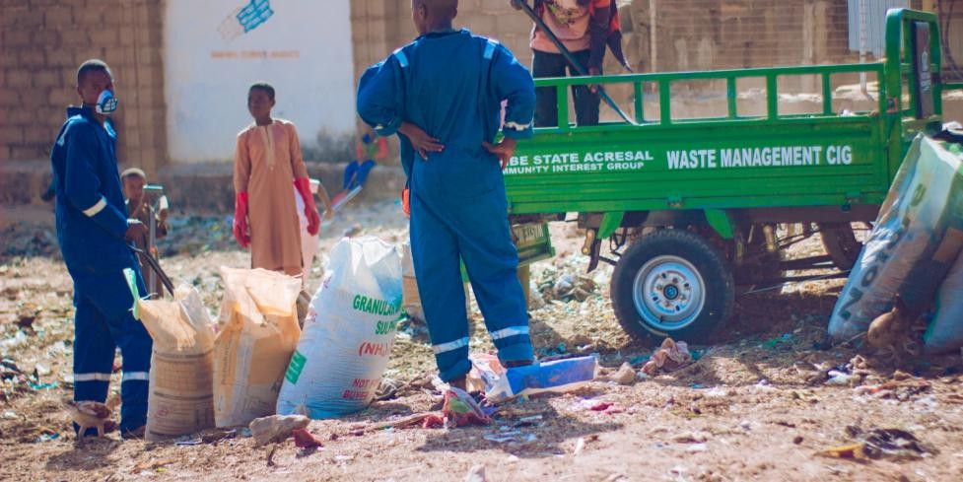
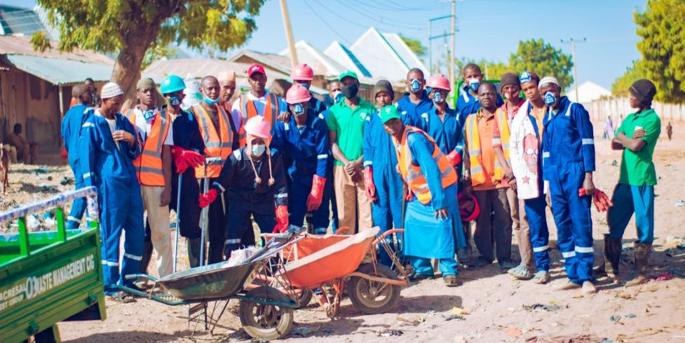
Weekly Environmental sanitation
Community sensitization on waste management
Component B1 Waste Management CIG
Impact:
Clean environment
Fewer cases of diseases among children
Income generation to support the family

Slide 22



It is an innovative strategy by the Gombe State ACReSAL to transform the state’s waste burden into opportunities for economic growth, energy security, and environmental sustainability.
Component B1 Waste To Wealth Facility

Slide 23


Component B2 Construction of Balanga Dam Canals and Reconstruction of Failed Sections
Water Storage Capacity: 63 MCM
Height: 41m
Surface area coverage: 1,000 ha
Expected ha to be irrigated: 11,000ha
Total Length of the canal: 23km
Volume of water to be stored: 368,000 cubic meters
Length covered by ACReSAL: 6km (6,329.3 ha)

Slide 24



Component B2 Construction of 30 Solar-Powered Boreholes

Slide 25




Component B2 Establishment of 11 Plant Nurseries with 50,000 capacity each
IMPACTS:
Attitudinal change towards raising plant nurseries among Communities
Planting of many seedlings by communities
and individuals.
Source of quality water for the seedlings, humans, and animals
15,176 beneficiaries.

Slide 26





Component B2 Community-Led
Landscape Restoration
4691.7 ha restored

Slide 27


Component B2
Afforestation
At Muhammadu Buhari Industrial Park.

Slide 28



Component B2 Planting with the wives of the 19 northern Governors
Planting for food and shelter: R-L
First Ladies planting trees
Kogi State First Lady (M), Haj. Sefinat Usman
Ododo
Kaduna State First Lady, Hajiya Hafsat Uba Sani

Slide 29




Component B2 Afforestation in Gombe Metropolis- Gov. House Drive covering 3km.

Slide 30




Component B2 Afforestation Activities in part of Gombe cont’d
Tumfure suburban community
NTA Kaltungo Sub-station Kalaring
NTA Kaltungo main station, Kalorgu
Muhammadu Buhari Industrial Park
Bage Junction - Bajoga

Slide 31




Component B2
Community strengthening
Distribution of 2,100 seedlings of moringa, pawpaw, cashew, and mahogany to 575 Women Groups and Farmers at Kwadon Yamaltu Deba LGA to:
Provide an alternative source of
livelihood and income
Enhance soil protection, medicinal values
Inculcate the habit of tree planting at the household level.

Slide 32




Component B2 10 km Roadside Afforestation in
Gombe Suburb- Pen Resource Academy, and College of Nursing, Gombe
Planting for environmental
protection and aesthetics.

Slide 33


Component B2
Restoration of degraded land at GGC Doma in Gombe.
Before
After

Slide 34



Component B2 Afforestation Activities
Plantation at Deradicalization Centre Malam Sidi
Police College, Kumo

Slide 35



Component B2 Gadam Locust Beans Plantation – Ongoing 30HA in 3 Senatorial Districts
Hundreds of people come daily to fetch water.
They traveled over 10km to fetch water from the unclean earth
dams before.
There are a total of 21 solar-powered boreholes constructed by the project with 13,466 beneficiaries.

Slide 36





Component B2
Community Engagement Activities – CRF
Presentation of Cheques to CRF Beneficiaries

Slide 37



Component B2 Community Revolving Fund (CRF) Cont’d
Approved amount = N350,000,000.00 ($ 250,000)
Total amount disbursed to CRFMCs = N350,000,000.00
Total amount disbursed to 10 communities = N 223,418,232.25
Total recovery
Total beneficiaries
Male
Female
Total number of CIGs
FCE (T) Catchment
Bajoga Catchment
Total number of Ha
Job created
= N216,269,668.47 (95.0%)
= 1,979
= 1,234
= 745
= 89
= 46
= 43
= 1,696
= 8,480

Slide 38





Component B2
Community Revolving Fund (CRF)
Nagari-Nakowa Multipurpose CIG showcased their non-timber forest products (NTFP).
25 members (22 Females, 3 Males
Received – N2,493,750
Paid – 2,150,00
They are investing the profit in non- timber forest products: tamarind, Baobab, beans, millet, cassava flour, and locust bean, among others

Slide 39


Component B2 Community Revolving Fund (CRF)
10 members (7 males, 3 females)
Received – N1,550,000
Paid – N600,000

Slide 40


Component B2 Community Revolving Fund (CRF)

Slide 41





Component B2 3000 Energy Efficient
Cook Stoves
Provides alternative cooking energy
Reduces attacks on the forest

Slide 42




Component B2
Drought-Resistant Seeds – 55 Farmer Groups (2,071 Farmers)
Key Impacts:
More efficient systems for crop production.
Improved establishment of crops.
Faster growth and establishment rates.
Enhanced yield and overall crop productivity.
Reduced production costs with a lowered environmental impact.

Slide 43

Component B2 Livelihood Support
To 192 CIGs
CRF – 89
Livelihood – 48
Farm Input - 55

Slide 44


Component B2 Livelihood Support
Fisheries CIG under the FCE(T)
• Livelihood options for 25 members supporting 250
beneficiaries
• Income generation to support families
• Reduction in divorce rates
• Improved health conditions through a balanced
diet
• N250,000 profit generated

Slide 45




Component B2 Livelihood Support
Smart Agriculture (Greenhouse CIG under the FCE(T)
• 25 members – 250 beneficiaries
• Income generation for families
• Provision of nutritious food
• Peaceful coexistence among
couples

Slide 46

Testimonies from Beneficiaries of Fishponds, Greenhouse, and Non-Timber Forest Products

Slide 47





Component B2
12 Tractors and
12 Tricycles for Smart Agriculture
Support local farmers to improve agricultural production

Slide 48



Component B2 IRRIGATION FARMING BY LOCAL FARMERS
250 Wash boreholes distributed

Slide 49



FAO ACTIVITIES
Hectares covered – 652ha

Slide 50




Peace Building Initiative
Key activities
Capacity building for EWER Committees
Distribution of Android Phones to enhance EWER
Key Impact:
Early detection and report on conflict
46 project-related conflicts identified
and resolved
2 major pre-ACReSAL conflicts resolved in Kanawa and Shongom

Slide 51




Groundnut Milling Machines
50nos. Procured for CIGs to enhance their production
Improved production capacity of the Groundnut CIGs

Slide 52

Component C
Institutional Strengtheningand Project Management
C1: Institutional and Policy Strengthening (US$46m)
Institutional Infrastructure (IT, office, connectivity)
Longer-term policy and institutional frameworks to promote integrated watershed management
across sectors, levels, and institutions
Capacity building and outreach (in-person and virtual training, internships)
C2: Project Management (US$33m)
Coordination at federal and state levels
Supporting technical assistance (e.g. M&E, data/analytics, implementation support)

Slide 53


Component C1
Provision of wildlife management gadgets for the Department of
Forest Resources
Impacts:
High-level of awareness in terms of Hippo/human conflict resolution
Enhanced rapid response to
emergency situations
Improved protection for hippos
Ease of data collection on wildlife species demography
improved workers productivity
improved farm production output due to good farmer/hippo
Hippo's relationship

Slide 54


Students from ATBU, Bauchi, on a learning visit
Stakeholders’ training on social cohesion in Bauchi
Component C1 Capacity Building
419 people from various MDAs and NGOs have been trained.

Slide 55


Component C1 Capacity Building
Stakeholder retreat on review of forestry law and GOSEPA policy in Bauchi.

Slide 56


Component C1
Renovation of the Ministry of Water, Environment, and Forest Resources
It houses the Ministries of Environment, Information, and GMC with a combined 300 staff members
Improved the working conditions of staff
Provision of laptops to improve efficiency
Before
After

Slide 57

Component C1
Provision of 2 operational vehicles (Hilux Vans) for the line MDAs:
Ministry of Water, Environment and Forest Resources
Agriculture, Animal
Husbandry and Cooperative

Slide 58

Background
The Agro-Climatic Resilience in Semi-Arid Landscapes (ACReSAL) project has made significant strides in environmental restoration, infrastructure development, and climate resilience across Gombe State. To ensure the long-term sustainability of these investments beyond the project lifecycle, the Gombe State Government has initiated a strategic transition plan.
Proposed Institutional Framework
To institutionalize and sustain the gains of ACReSAL, the government has developed a framework for the establishment of a dedicated agency:
Agency Name:
Component C1 Sustainability Strategy for ACReSAL
Investment in Gombe State
Gombe State Integrated Watershed Management Agency - GSIMA
Mandate:
Oversee post-ACReSAL project activities
Manage watershed and climate resilience programs
Coordinate environmental sustainability efforts across LGAs
Serve as a central body for future donor and government-funded interventions
Legislative Progress
The proposal for the establishment of the agency has been formally submitted to the Gombe State House of Assembly for legislative consideration and passage.
4. Strategic Importance
Ensures continuity of ACReSAL’s impact
Strengthens institutional capacity for climate adaptation
Promotes integrated watershed management
Positions Gombe State as a model for post-project sustainability in Nigeria

Slide 59


FCE (T) Catchment
Impact Documentary

Slide 60
Gombe State Progress of Activities across Components
S/N | Task / Activity | Sub-component | Status | Progress
1 | Identification of strategic watershed boundaries | A1 | Achieved | Boundaries identified
2 | Establish knowledge base on watersheds | A1
3 | Stakeholder engagement / inter-ministerial coordination | A1 | Achieved | Stakeholder engagements through meetings, sensitization, trainings and consultations. This includes members of the SSC/STC and other critical holders
5 | Field trips and knowledge exchange visits | A1 | Pending
6 | Development of watershed management plans | A1 | Achieved | 2 have been developed: FCE(T) and GGSS Doma
7 | Prioritization workshop for watershed investments | A1 | Achieved
8 | Appraisal and validation of watershed plans | A1 | Ongoing
9 | Capacity building for Catchment Management Structures | A1
10 | Nursery operations | A2 | Ongoing | Establishment of 11 Plant Nurseries with 50,000 capacity each. The areas are fenced and provided with solar-powered boreholes for watering seedlings and human consumption.
11 | Watershed/catchment management to reduce sedimentation | A2 | Ongoing
12 | Construction/rehabilitation of small storage systems | A2
13 | Irrigation development | A2 | Ongoing | Gombe State ACReSAL has constructed and extended the failed Balanga Dam canal, covering 6 km (6,329.4ha)
14 | Flood control and erosion works | A2 | Ongoing | 2 sites: 21 km FCE(T) (98% completed) and the 18 km GGSS Doma (15%), 57,453.8 ha restored.
15 | Community sensitization on erosion control | A2 | Achieved | Local government and communities have been sensitized.

Slide 61
Progress of Activities across Components
16 | Groundwater recharge area identification | A2 | Ongoing | Studies have been conducted for 6 dams and 12 irrigation sites.
17 | Rangeland & fodder management | A2 | Ongoing | Gombe State ACReSAL is partnering with JUNCAO and L-PRES to develop the Zenge Wawa Forest Reserve into a rangeland and fodder management system to mitigate farmer-herder conflict.
18 | Wetland restoration and management | A3 | N/A
19 | Area under improved catchment management (Ha) | A3 | Ongoing | 63,151.2 ha through afforestation, gully rehabilitation and urban storm drains desilting.
20 | Forest management | A3 | Ongoing | Upgrade of Kanawa Forest to a Biosphere Resort and Botanical Garden. The essence is to promote research, education, and training initiatives to minimize biodiversity loss and strengthen ecosystem resilience
21 | Protected area management | A3 | Ongoing
22 | Total water storage capacity added or restored through project interventions (m3) | A3 | Achieved | Seasonal reduction of 9 million liters (9,000 m3) of surface runoff through water harvesting in the upper catchment of the FCE(T).

Slide 62
Assessment of ACReSAL Project’s
Component B
S/N | Task/ Activity | Sub-Component | Status | Progress
1 | Micro-watershed planning (200 MWPs) | B1 | Ongoing
2 | Stakeholder identification for MWP | B1 | Ongoing
3 | Development, appraisal & validation of MWPs | B1 | Ongoing
4 | Community sensitization | B1 | Ongoing | Community sensitization is a continious process
5 | Formation/strength ening of community groups | B1 | Achieved | A total of 192 Community Interest Groups (CIGs) have been established and are being supported with various livelihood options.
6 | Peacebuilding initiatives | B1 | Achieved | Capacity has been built for ACReSAL Staff and stepped down to EWER committee members on conflict resolution. 46 different project-related conflicts were identified and resolved. 1 pre-ACReSAL conflict was resolved in Kanawa.
7 | Establishment of NRM Committees | B1 | Achieved | Landscape restoration management committees have been established in each state.
8 | Development of GBV protocol | B1 | Achieved | Action plan, developing

Slide 63
Assessment of ACReSAL Project’s
Component B
S/N | Task/ Activity | Sub-Component | Status | Progress
9 | Community-based GRM | B1 | Achieved | Grievance Redress Committees (GRC) have been formed across the intervention communities. They have been handling GRM cases successfully in line with training and established SOP
10 | Capacity building (cohesion, conflict mgmt) | B1 | Achieved | EWER committees have been established and trained, and they are actively working and reporting on potential conflicts.
11 | Training of GBV service providers | B1 | Achieved | Service provider mapping at the point of data collection
12 | Community GBV/GRM training | B1 | Achieved | Community GBV/GRM training and sensitization have been conducted by Gombe State PIU for all the GBV and GRM committees.
13 | Community waste management planning | B1 | Ongoing | 110 Waste bins distributed, 24 waste collection centres under the FCE(T) Catchment. A waste-to-wealth facility has also been constructed for sorting out waste and converting to use.
14 | Waste management groups formation | B1 | Ongoing | 7 waste management CIGs formed and supported.
15 | Community-led landscape restoration | B2 | Ongoing | 4,691.7ha has undergone site preparation, planting, and agroforestry integration using a CDD approach as part of the afforestation activities
16 | Engagement of technical partners | B2 | Achieved | FAO has been engaged. The project has been working with PxD in supporting local farmers in terms of Digital Precision Agriculture and Extension.

Slide 64
Assessment of ACReSAL Project’s
Component B
S/N | Task/ Activity | Sub-Component | Status | Progress
17 | Procurement of Delfino ploughs | B2 | Ongoing | process of procuring Delphino plough is on-going
18 | Site selection & phasing | B2 | Achieved | Sites have been selected and land restoration started in some states
19 | Pre-planting operations | B2 | Ongoing | Land preparation: clearing invasive species, ploughing, soil testing. Nursery readiness: ensure seedlings are available
20 | Engagement of cooperatives | B2 | Achieved | Farmer cooperatives mobilised for ownership and sustainability. Planting, maintenance, and monitoring agreements done with cooperatives, capacity building on climate-smart practices and agroforestry and coorperatives were linked to value chains for economic incentives (NTFPs, improved crops).
21 | Training of trainers | B2 | Achieved | Training of trainers has been conducted in Abuja. This was the first FAO activity. It has also been stepped down.
22 | Finance for inputs & value chains | B2 | Achieved | 12 tractors, 12 tricycles, seeds, seedlings, and other supplies have been purchased for land restoration.
23 | Establish community nurseries | B2 | Achieved | 11 nurseries have been established, each with a production capacity of 50,000 seedlings.
24 | Promote NTFP value chains | B2 | Achieved | A Community Interest Group (CIG) has been established specifically to focus on the production of non-timber forest products. The CIG is into the production of Baobab powder, g/nut cake, locust beans seasoning, etc.

Slide 65
Assessment of ACReSAL Project’s
Component B
S/N | Task/ Activity | Sub-Component | Status | Progress
25 | Climate-smart rainfed agriculture | B2 | Ongoing | The state is supporting agroforestry by distributing drought-tolerant seedlings and promoting the use of organic manure.
26 | Extension & technical assistance | B2 | Ongoing | 2,071 farmers have been identified and are receiving services through DPAE, along with support from soil value assessments.
27 | Revolving funds establishment | B2 | Ongoing | Approved amount = N350,000,000.00 ($ 250,000). Total amount disbursed to CRFMCs = N350,000,000.00. Total amount disbursed to 10 communities = N223,418,232.25. Total recovery = N216,269,668.47 (61.7%).
28 | Community storage & processing facilities | B2 | Achieved | One storage facility in Plateau and one processing Center in Shedda FCT
29 | Farmer-led irrigation development | B2 | Achieved | 250 wash boreholes have been distributed to the local farmers. 9 solar- powered boreholes have been constructed to provide clean water for human consumption and animals.
30 | Water and soil conservation | B2 | Ongoing | 3 greenhouses have been established for smart agriculture.
31 | Improved crop varieties & climate tech | B2 | Ongoing | Improved crops have been procured and distributed improved crops to farmers.

Slide 66
Progress of Activities across Components
1 | Monitoring infrastructure investment | C1 | Ongoing | The project is providing Support to NESREA to enhance the agency’s operational capacity in enforcing environmental regulations. Support has been provided to the Gombe Goes Green – 3G Project
2 | Institutional infrastructure (IT, offices) | C1 | Achieved | The PIU is fully equipped with ICT tools with a befitting office. This has improved the performance of the staff members.
3 | Knowledge platforms & information services | C1 | Achieved | Gombe state ACReSAL has established a data room for the forestry unit under the ministry of environment for monitoring movement of hippos across the Dadin-Kowa reservoir.
4 | Online analytics & data systems | C1 | Achieved
5 | Policy improvement for ILM | C1 | Ongoing | The development of an Integrated Landscape Management (ILM) Policy and Action Plan is ongoing.
6 | Capacity building & outreach | C1 | Achieved | Capacity Building and Outreach(Partnership arrangements with CSOs, academic institutions, private sectors, Outreach initiatives )have been implemented. 11 CBOs under FNGO and trained to support project implementation at the local level
7 | Project coordination & supervision | C2 | Achieved | The SPMU is fully functional and effectively contributing to the achievement of the PDO.

Slide 67
Progress of Activities across Components
8 | Procurement, FM, safeguards oversight | C2 | Achieved
9 | Monitoring & evaluation systems | C2 | Ongoing | M&E manual in place, Management Information System (MIS) with both offline and online data entry capabilities is functional. Tracking of Project implementation is a continuous process
10 | Communication & mobilization | C2 | Ongoing | The project has raised awareness, mobilized communities and shared information with the public through the mass media, social media and interpersonal communication.
11 | Reporting to stakeholders | C2 | Achieved | This has been a priority where regular official updates are given to the stakeholders, especially members of the SSC/STC, on project implementation activities. Knowledge sharing has been an integral part of the project implementation.

Slide 68
Impact Summary
KEY INDICATORS | COMPONENT | OVERALL TARGET | COMBE STATE CONTRIBUTION | KEY WORKS | STATUS
Area under improved catchment management | A2 | 70,000 | 63,151.24691 | Gully erosion control, Urban Drainage desilting and afforestation | Completed
Area under community-led landscape restoration | B2 | 350,000 | 852.4977819 | FAO land restoration and CRF farms | Ongoing
Area provided with new/improved irrigation or drainage | A1 | 10,000 | 6,329.352987 | Dam channelization for irrigation farming | Phase 1 completed
Area under improved rainwater harvesting | A2 | 100,000 | 715.956767 | Rainwater harvesting at the FCE (T) intervention area | Completed
Total |  |  | 71,049.05445

Slide 69
Impact Summary different table
State | Indicator | Interv_Typ | Sum of Area_Impac
Gombe |  |  | 71,049.05445 6,329.352987 6329.352987 4,469.295776 209.3091373 97.40808885 12.84546558 2962.506273 321.4047892 13.32424081 200.4176262 652.0801557 59,534.44892 222.4772216 57453.83075 1858.140948 715.956767 715.956767
 | Area provided with new/improved
 | irrigation or drainage services
 |  | Irrigation
 | Area under community-led landscape
 | restoration
 |  | Afforestation (Avenue Planting)
 |  | Afforestation (Institutional
 |  | Planting)
 |  | Afforestation (Orchard)
 |  | Afforestation (Shelterbelt)
 |  | Afforestation (Tree Planting)
 |  | Afforestation (Woodlot)
 |  | CRF Activity
 |  | FAO Landscape Restoration
 | Area under improved catchment
 | management
 |  | Afforestation (Forest and
 |  | Protected Area Management)
 |  | Civil Works (Gully Erosion Control)
 |  | Desilting (Urban Drainage
 |  | Desilting)
 | Area under improved rainwater harvesting
 |  | Water Harvesting
Grand Total |  |  | 71,049.05445

Slide 70
Thank you.

